Slide 1


OWTCCom@USPS.org

Slide 2
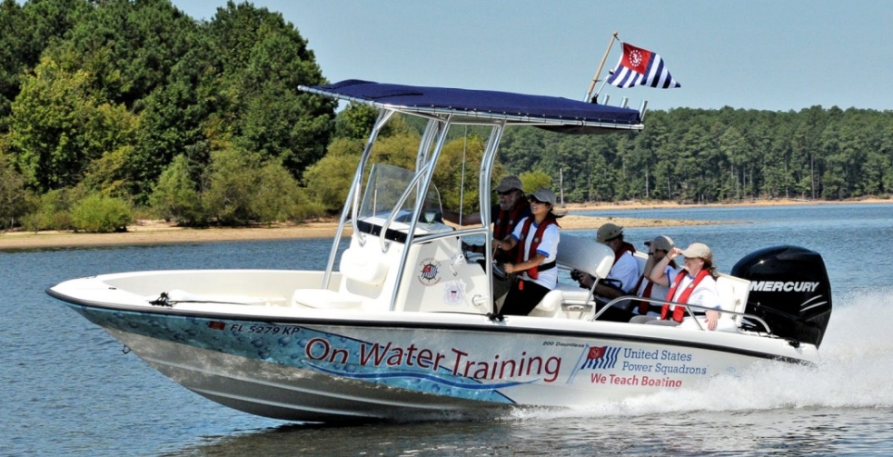
Hands-On Training:
On Water
Basic Powerboat Training

Slide 3
Hands-On Training:
Basic Powerboat

Slide 4

About the Program
Hands-On Training – Basic Powerboat was developed by the United States Power Squadrons under a grant from the U. S. Coast Guard.
It meets the National On-Water Standards for powerboat operation and instruction

Slide 5
Program Objectives
You already know the basic rules and principles of boating by taking a safe boating course.
This program will take you beyond these basics and focus on developing and refining your boat handling skills. The objectives of the course are to:
Develop an understanding of boat behavior
Learn practical boat handling techniques
Perform hands-on exercises to build skills

Slide 6
What Can You Expect?
We’ll cover a lot of material
We’ll build progressively
We’ll reinforce Key concepts
Understand Concepts
Learn Techniques
Perform Exercises
Master
Skills
Mastering the skills takes
time, and people acquire
skills at different rates.

Slide 7
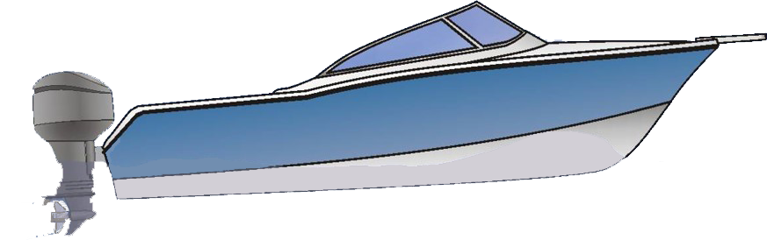
The Training Boat
We will examine different types of boats throughout this training and discuss some of the different handling characteristics.
The boat we will actually use for training is is a powerboat under 26’ in length with a single outboard or inboard/outboard engine.

Slide 8
Understanding Boats
Why do boats behave the way they do?

Slide 9
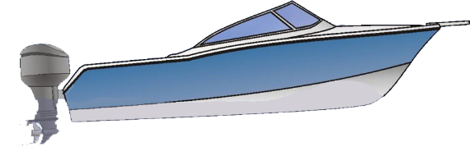
What Influences the Boat?
Momentum
Shape of the Boat
Steering
Thrust
Wind and Current
Boat Trim

Slide 10
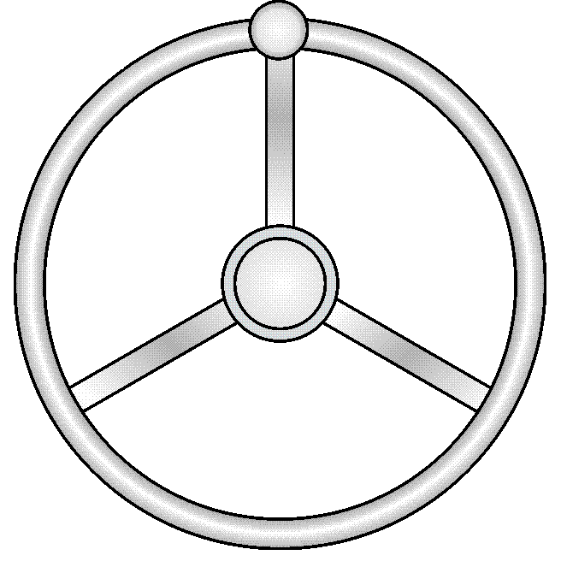
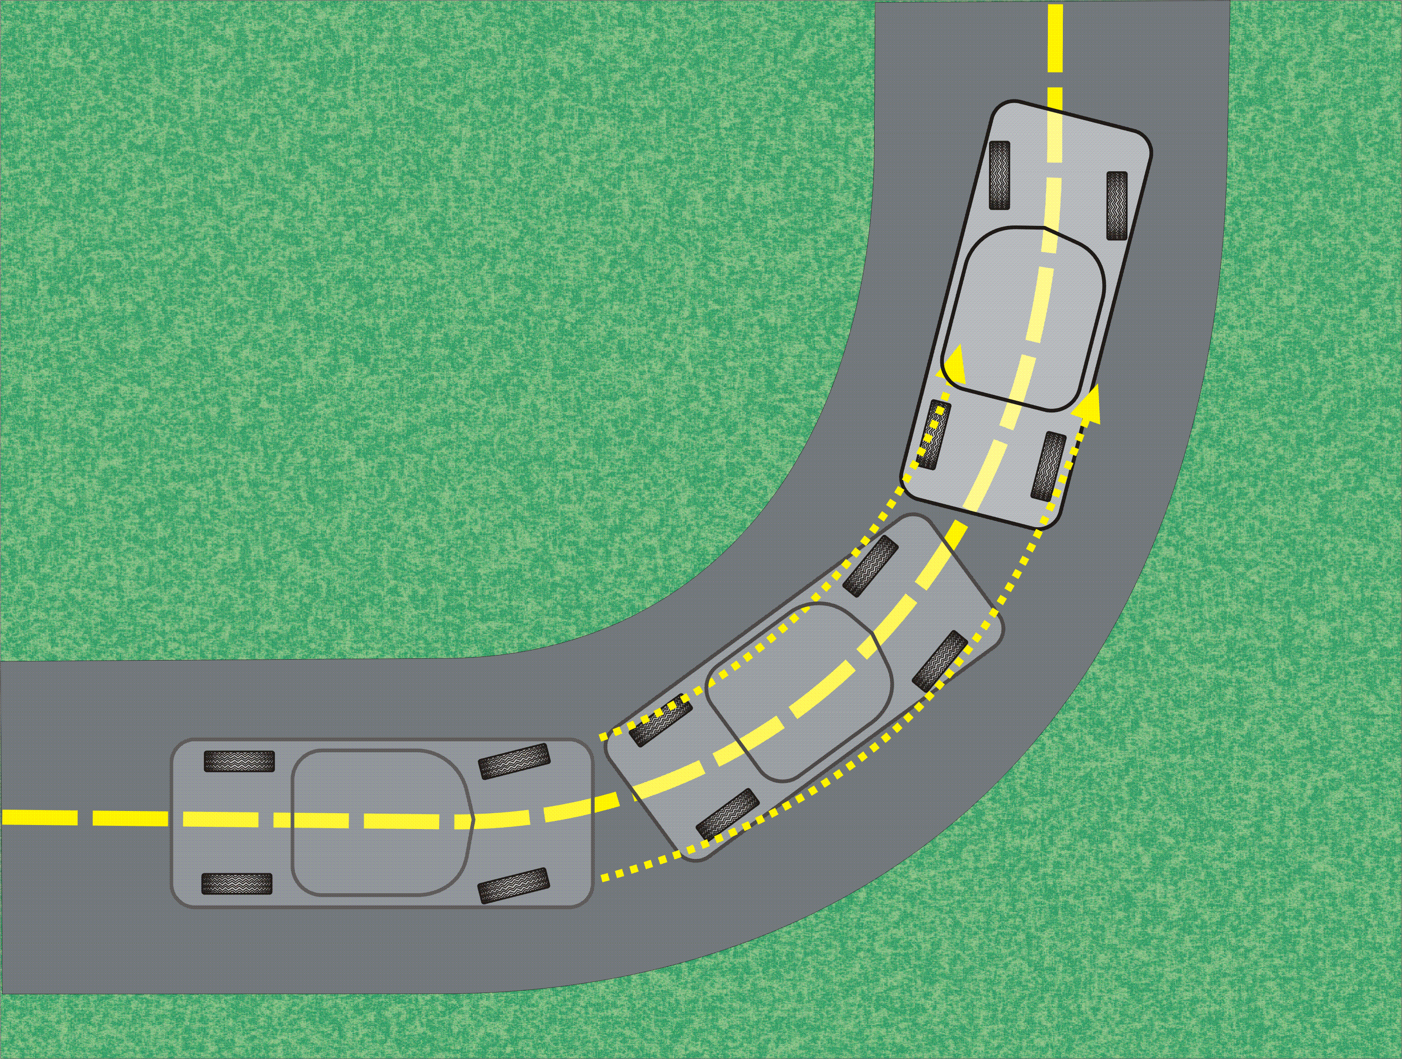
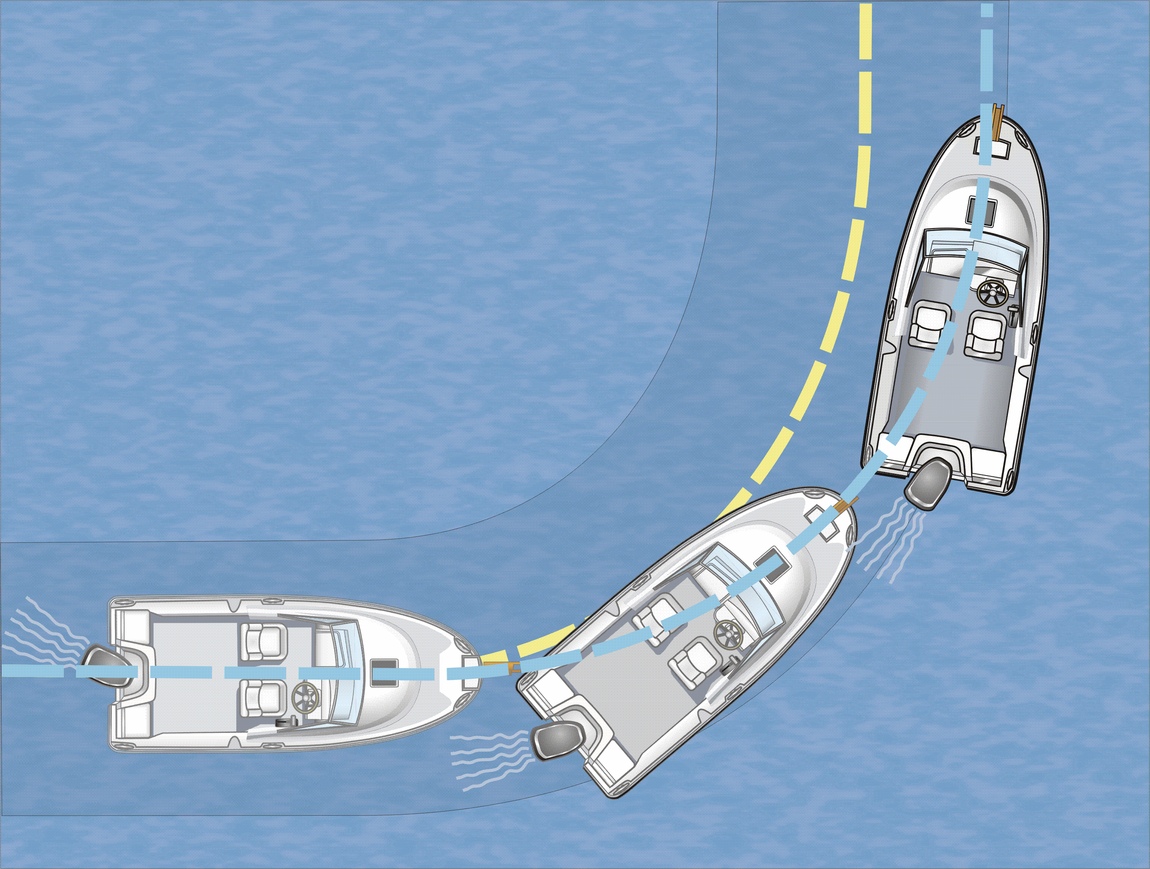
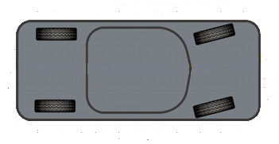
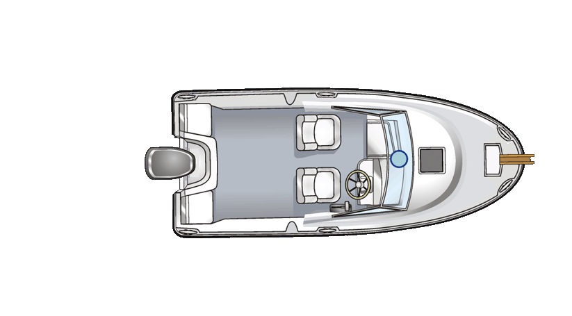
Steering
A boat has a steering wheel very much like a car. But the way a boat steers is very different.
Cars steer from the front
Boats steer from the stern
Cars grip the road and steer precisely
Boats tend to slide as they turn

Slide 11
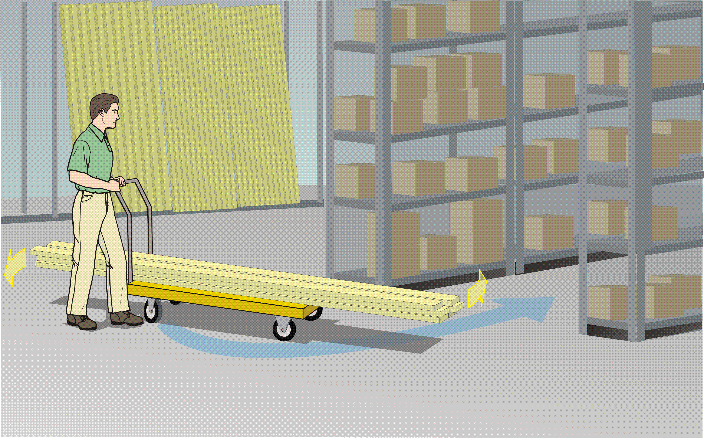
Steering from the Back
Steering a boat is like steering a lumber cart at the hardware store – you swing the back end to point the cart in the right direction.

Slide 12
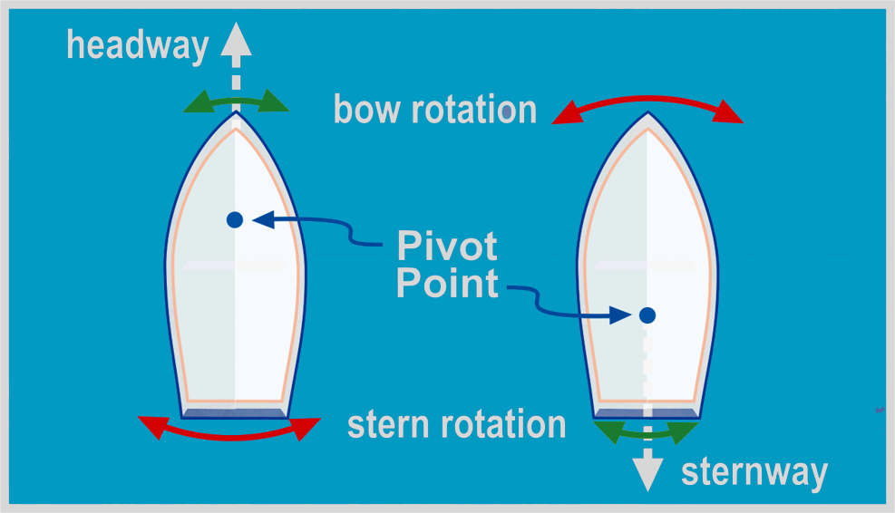
Steering and Pivot Points
Boats turn around a center point called the “pivot point.” The location of the pivot point depends on the hull shape and the direction of travel.
For most power boats:
About 1/3 waterline distance back in forward gear
About 1/3 the waterline distance from the stern in reverse
For sailboats, the piv0t point is somewhat fixed by the keel

Slide 13


Thrust
The thrust is provided by the propeller. Most single engine propellers are “right-handed,” meaning they turn clockwise when viewed from the rear.
On most small powerboats, the throttle and gear shift are combined into a single control. Many are cable-driven, but some are electronic. Shift smoothly and precisely to avoid grinding the gears.
Forward
Forward Idle
Neutral
Reverse Idle
Reverse
Trim Switch
at thumb

Slide 14
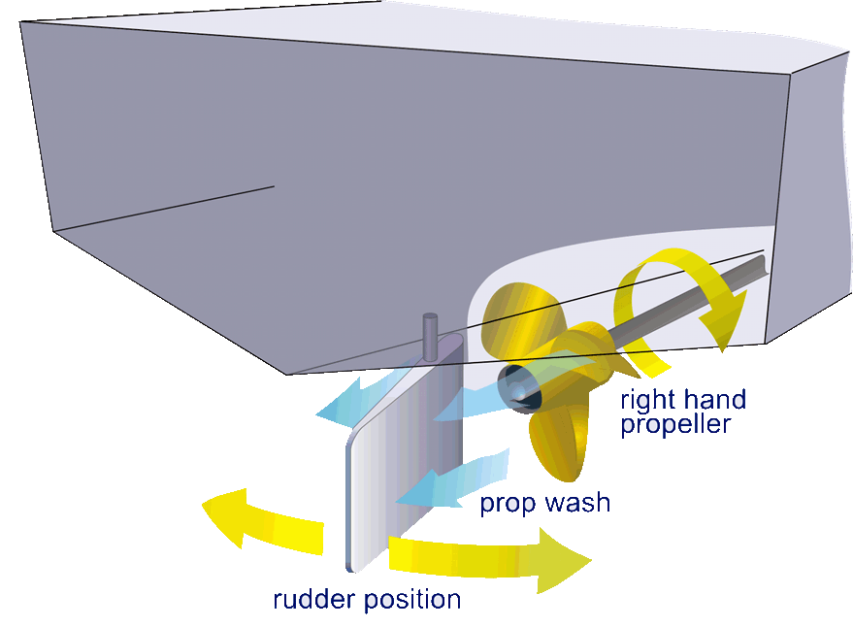
Steering and Thrust - Inboard
In a powerboat, steering and thrust are closely related.
For an inboard engine:
The propeller is fixed
The steering controls the rudder
Water from the prop flows across the rudder.
The rudder deflects the prop wash to steer the boat

Slide 15
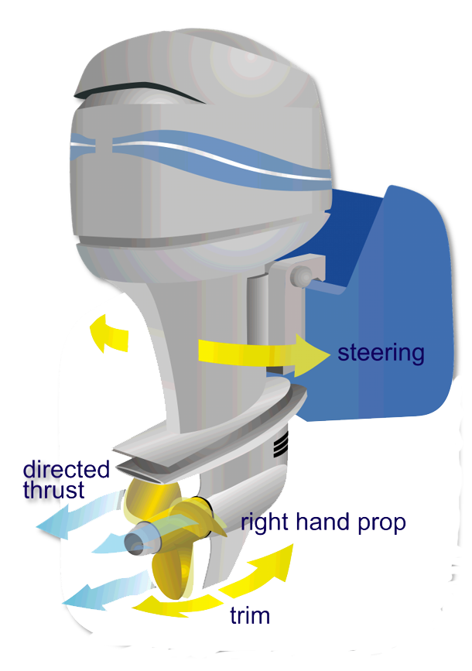
Steering and Thrust - Outboard
For an outboard engine:
The steering turns the entire motor
The directed thrust steers the boat
The engine can also tilt up and down to adjust trim
There is moderate rudder effect when the propeller isn’t turning

Slide 16
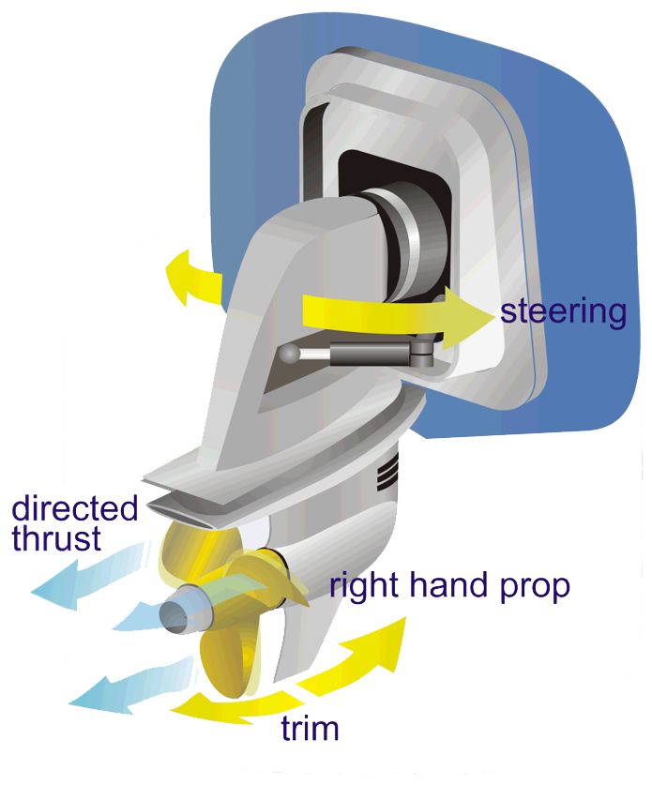
Steering and Thrust – I/O
For an inboard/outboard drive:
The lower unit behaves just like an outboard motor
The steering turns the entire lower unit
The directed thrust steers the boat
The lower unit can also tilt up and down to adjust trim
There is moderate rudder effect when the propeller isn’t turning

Slide 17
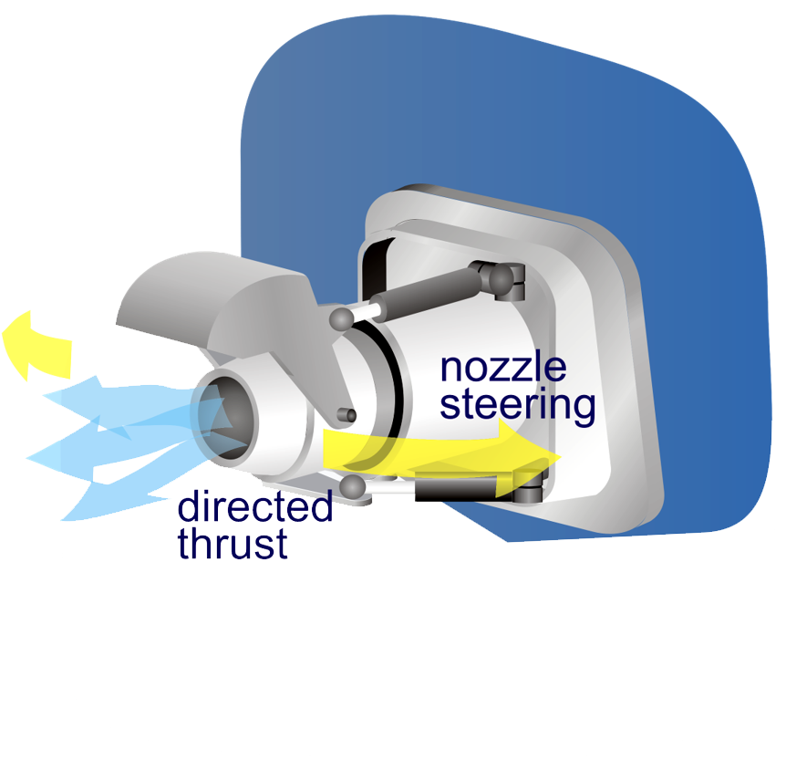
Steering and Thrust – Jet Drive
For a jet drive engine:
The steering directs the nozzle from side to side
The directed thrust steers the boat
There is no rudder effect, so there is no steering when there is no thrust

Slide 18
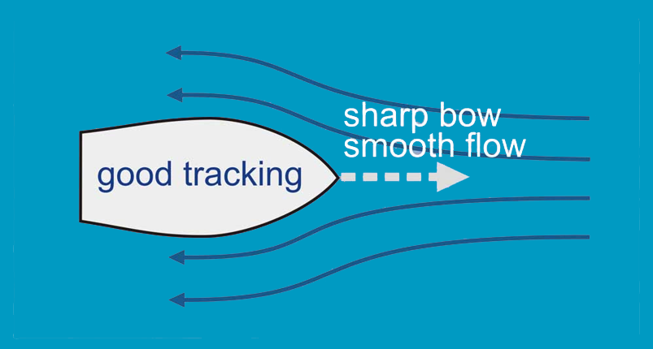
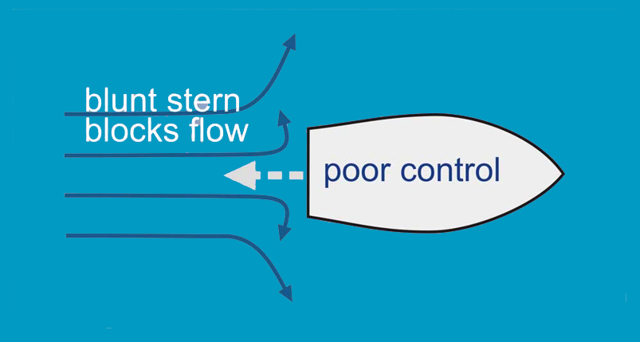
Operating in Reverse
Boats are optimized for forward motion:
Shape of the hull
Shape of the propeller
Position of the rudder
In reverse:
Handling may be unpredictable
Boats often prefer backing to one side, rather than straight

Slide 19
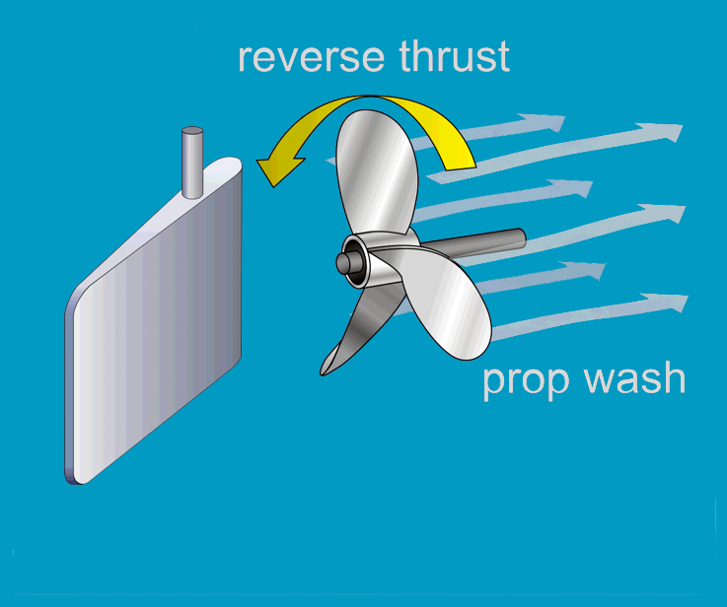
Operating in Reverse - Inboard
The prop wash is directed away from the rudder
There is no side force, and no effective steering
If the boat moves fast enough to build a flow across the rudder, there will be some steering control

Slide 20
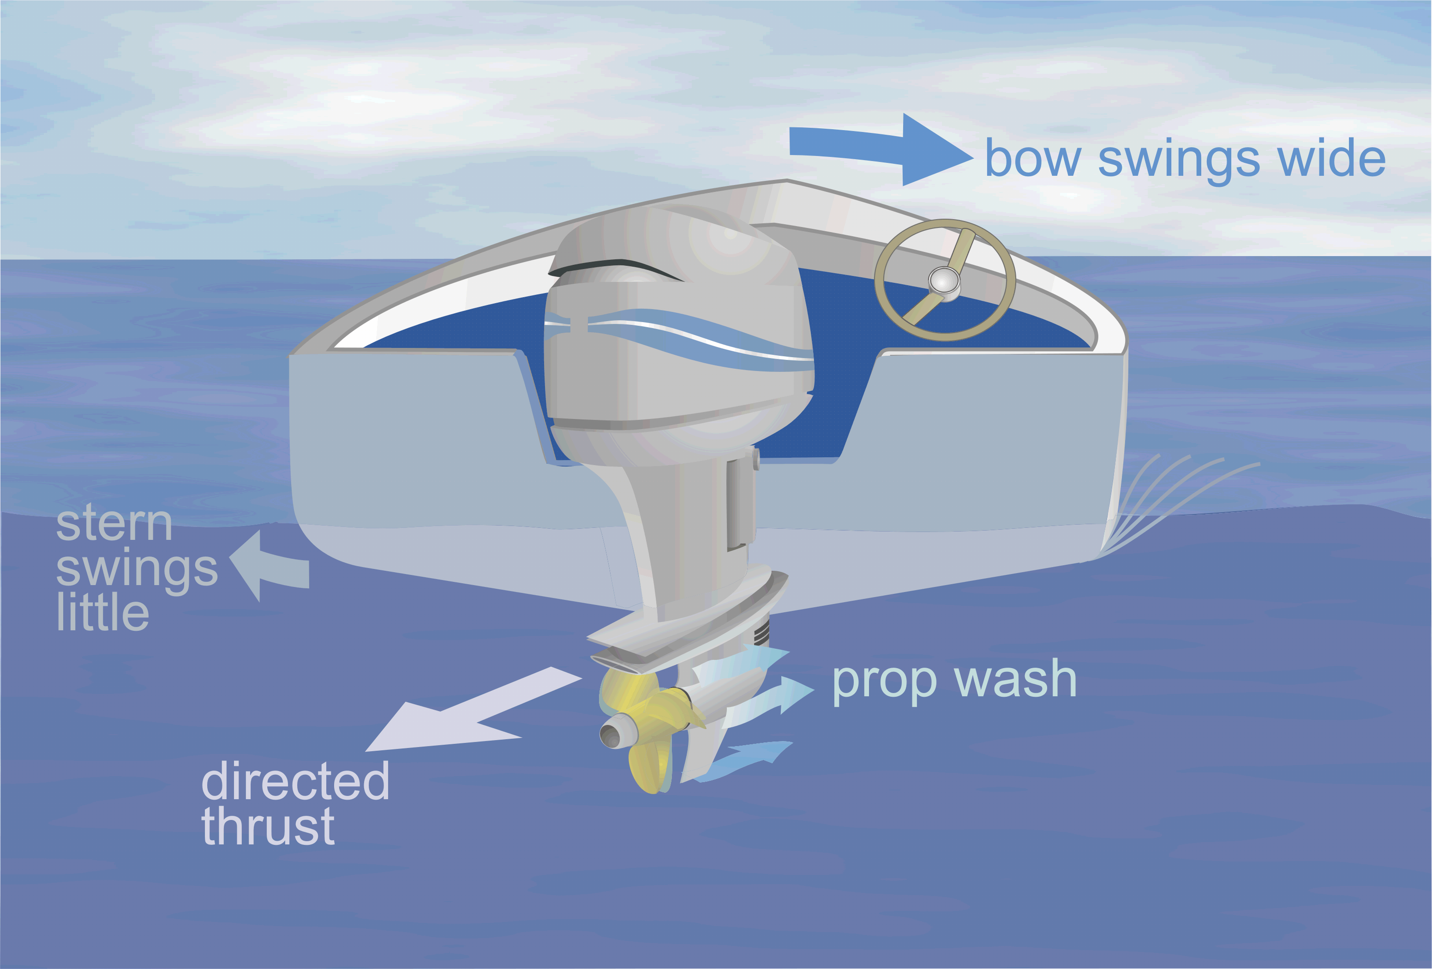
Operating in Reverse - Outboard
The outboard motor is more effective in reverse:
Steering is able to direct the thrust and provide directional control
Inboard/Outboard is similar to the outboard in reverse
The shape of the hull has a significant impact on handling

Slide 21
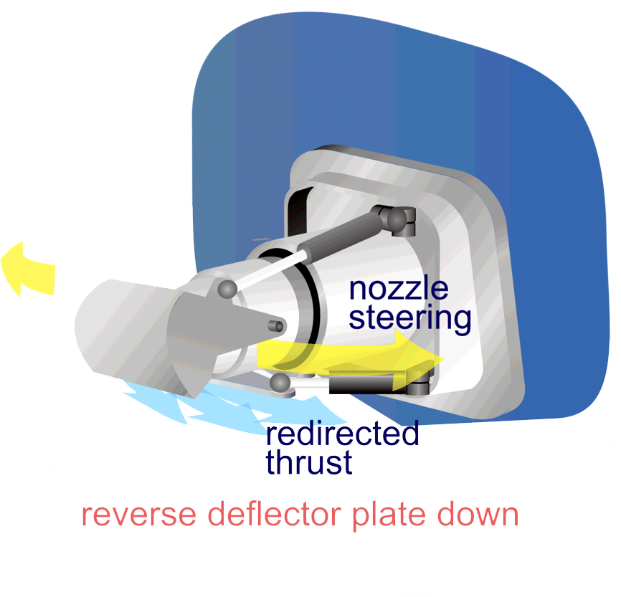
Operating in Reverse – Jet Drive
A deflector plate is used to redirect the thrust
The flow is directed downward and forward
Steering may be erratic and inconsistent

Slide 22
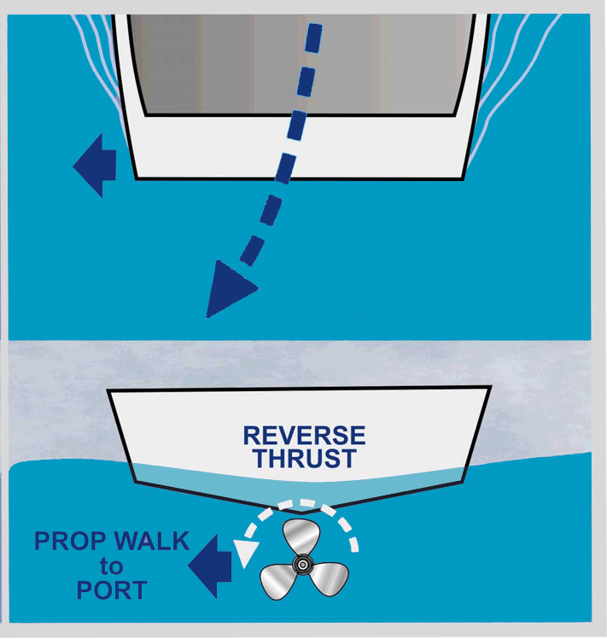
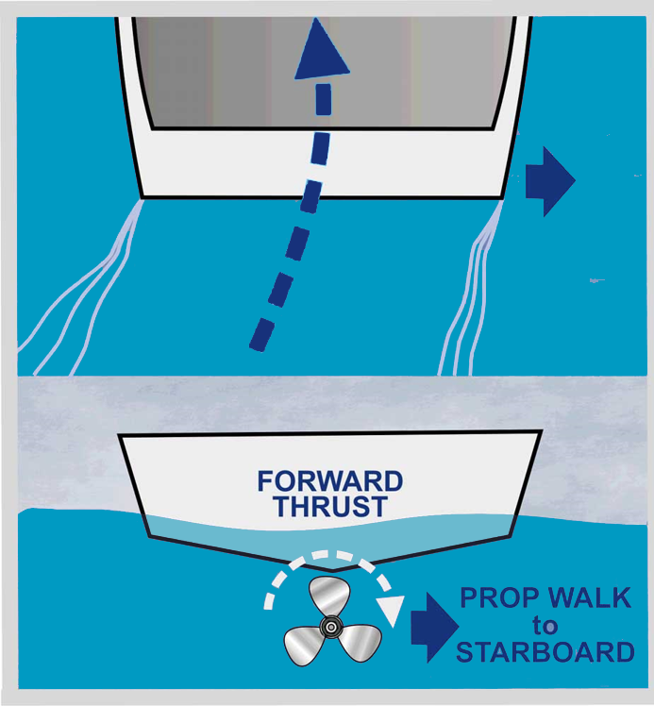
Prop Walk
A propeller will develop side forces, also known as “prop walk”
Most noticeable at low speeds
Tends to move the stern sideways
Direction changes with gear

Slide 23
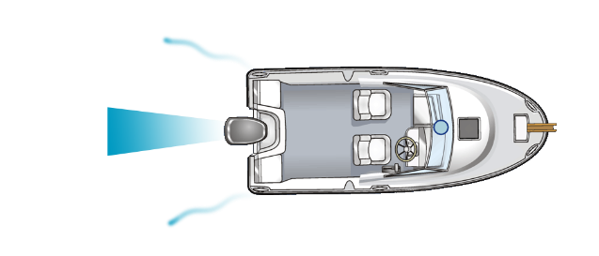

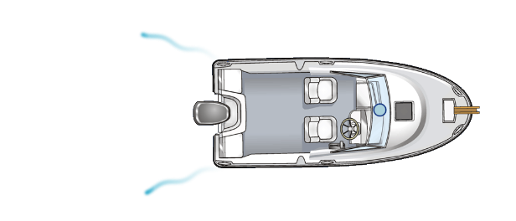
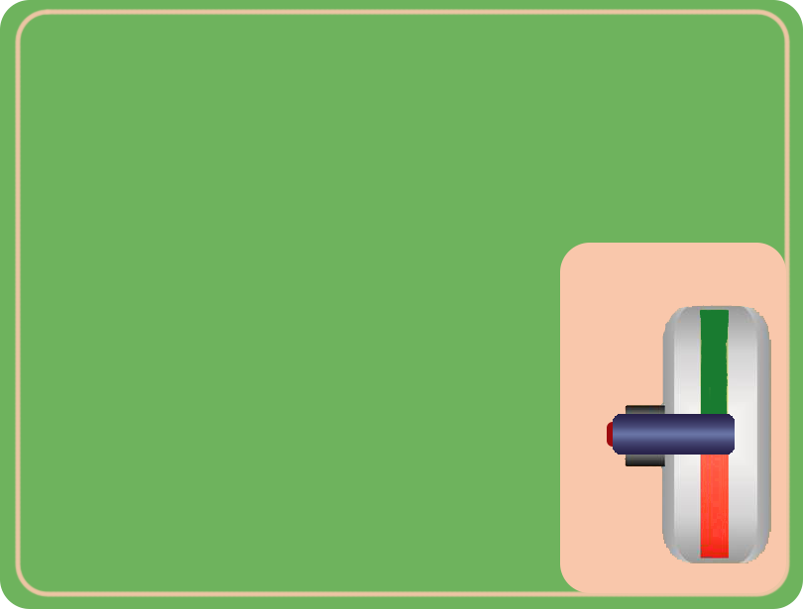
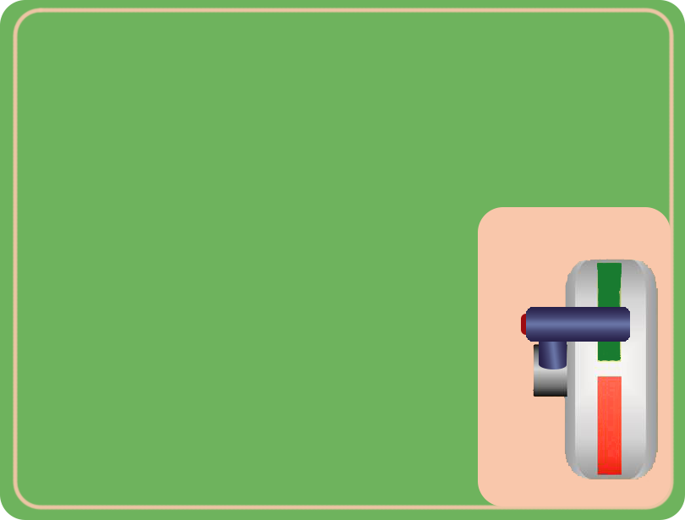
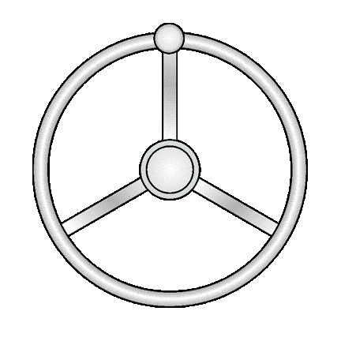
Linear Momentum
Once underway, if you cut the power, the boat will keep moving for some distance
The boat keeps moving
Shift to neutral

Slide 24
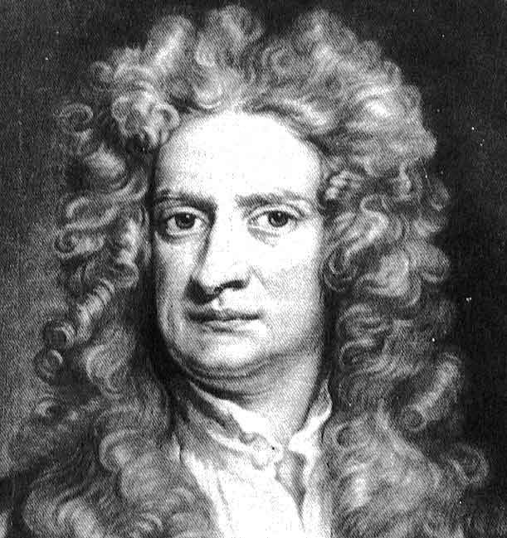
Momentum
My first law of motion!
Once the boat is set in motion…
It will continue to move in that direction
…even after power is removed
…unless acted on by another force
There are two types of momentum:
Linear - straight line
Rotational - turning
The amount of momentum depends on the size and speed of the boat
Sir Issac Newton

Slide 25
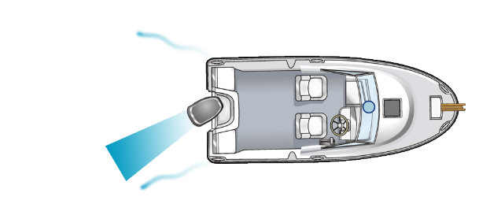
Rotational Momentum
Once the boat begins turning, it keeps turning after you straighten the wheel
Turn to starboard
Straighten the wheel
Boat continues to turn

Slide 26
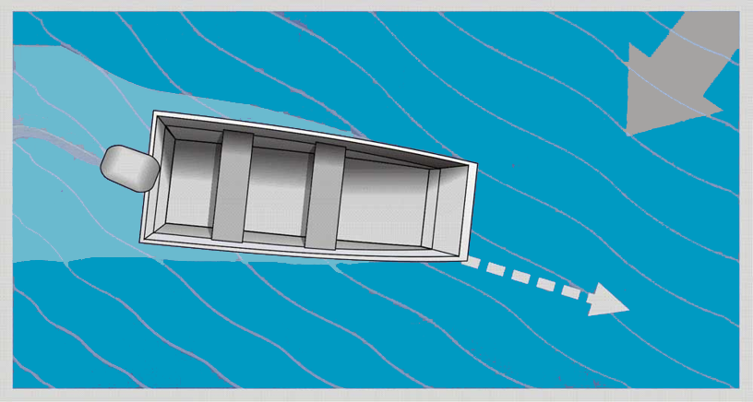
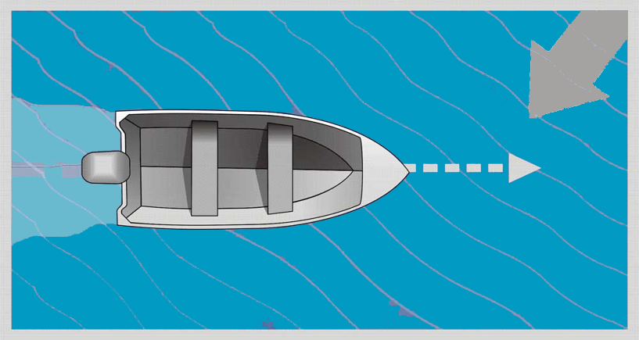
Shape of the Boat
The shape of the boat will affect how it rides and handles
A flat bottom boat will be stable, but will have difficulty tracking in the wind
Boats with a more pronounced keel will track more easily, but tend to rock more
Most boat designs are a compromise designed to provide good performance in a variety of conditions

Slide 27
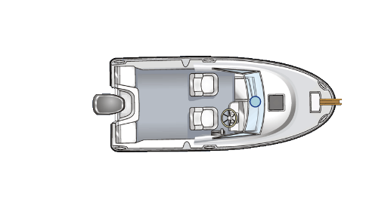
Wind and Current
Wind and current will each have a different effect on the boat.
Wind will have greater effect on the bow than the stern
The boat will tend to turn downwind
Current affects the bow and the stern
The boat will tend to move along with the current

Slide 28
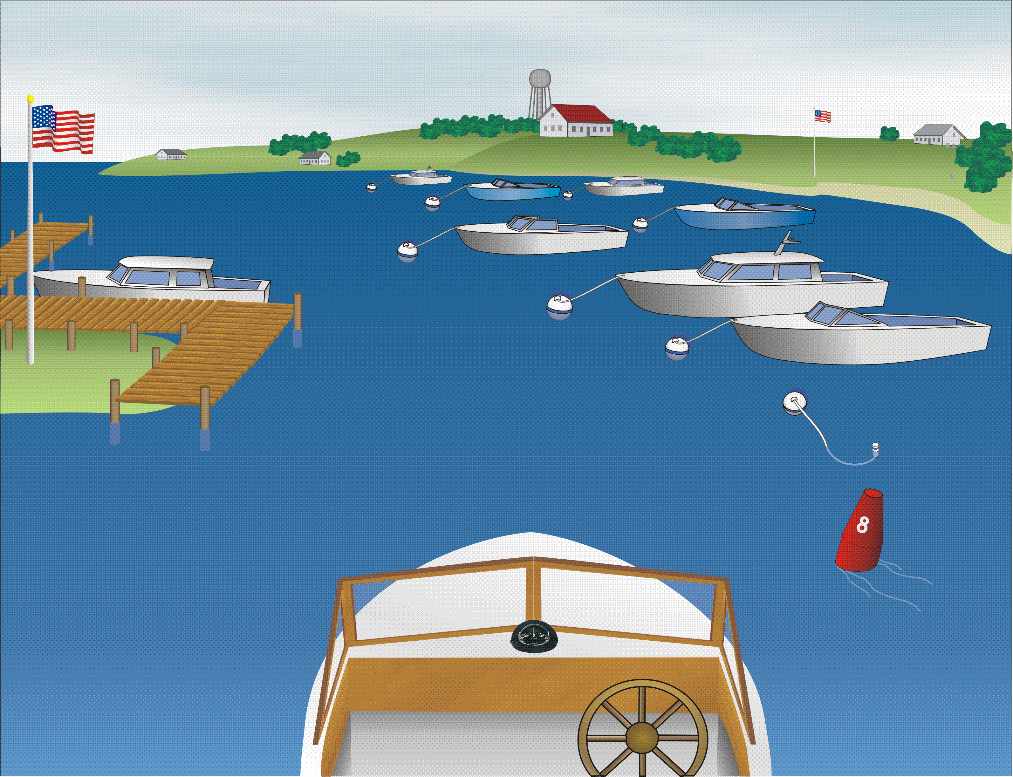
Observing Wind and Current
Check for telltales
Flags
Buoys
Moored boats
Floating objects
What story does this picture tell?

Slide 29
Behavior Changes with Speed
At what speed are the factors most influential?
Slow
Boat Speed
Fast
Wind and Current
Momentum
Shape of the Boat
Thrust
(Prop Walk)
Thrust
Steering

Slide 30
Basic Techniques
Fundamental techniques for boat handling

Slide 31

Situational Awareness
Be aware of your environment at all times
  Around you – boats, docks, swimmers
  Above you – the weather
  Below you – water depth, obstructions
Your environment is continually changing
  Keep a constant lookout
  Identify potential threats
  Track them as the situation evolves
  Take early action to avoid problems

Slide 32
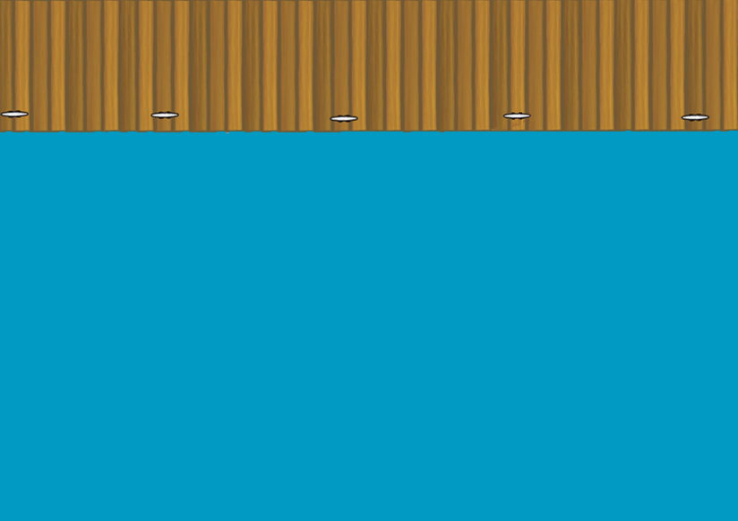
Always Plan Your Maneuvers
Observe your situation
  Check your passengers
  Note other boats or obstructions
  Check for prop clearance
Observe your environment
  Determine the effects of wind and current
  Determine the boat’s momentum
Plan your course of action
  Choose your goal – be specific
  Think through your maneuver
  Plan an “escape” route in case things don’t work out

Slide 33
Use Conditions to Your Advantage
When possible, perform low speed maneuvers while going into the wind or current
This offsets your boat speed, reducing your speed relative to docks and fixed objects
Maintain better control at a lower speed

Slide 34
Follow your Plan
Execute your maneuver as planned
Observe how the boat responds
Make adjustments as necessary
If you can’t complete the maneuver safely:
  Use your escape route
  Determine what went wrong
  Adjust your plan and try again

Slide 35
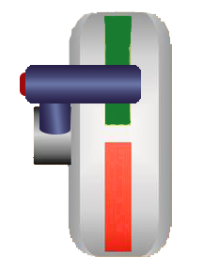
Low Speed Maneuvering
When operating at low speeds:
Thrust is low
Steering is less effective
The effects of wind and current are greater
Rotational momentum and prop walk are more noticeable
Practical techniques for low speeds:
Counter-steer to maintain your heading
Make the most of your steering
Use intermittent thrust
Stopping the boat
Close quarters maneuvering

Slide 36
Maintaining Your Heading
A boat will tend to wander at low speeds. This is due to wind, current, and rotational momentum.
  Steer to a specific target on the horizon
  Anticipate changes in heading
  Counter-steer to correct for the movement
  Adjust your target for wind and current

Slide 37
Make the Most of your Steering
Maximize steering at low speeds – only apply thrust when the wheel is pointed in the desired direction
  Shift to neutral
  Turn the wheel
  Apply momentary throttle
  Shift back to neutral
  Coast and observe
  Adjust the steering and repeat as needed

Slide 38
Use Intermittent Power
At idle speed, a boat will go 5-7 miles per hour. Use intermittent thrust to go even slower:
Shift into forward briefly “1-2-3”
Shift into neutral and coast
Directional control will diminish
Repeat as necessary to maintain your heading

Slide 39
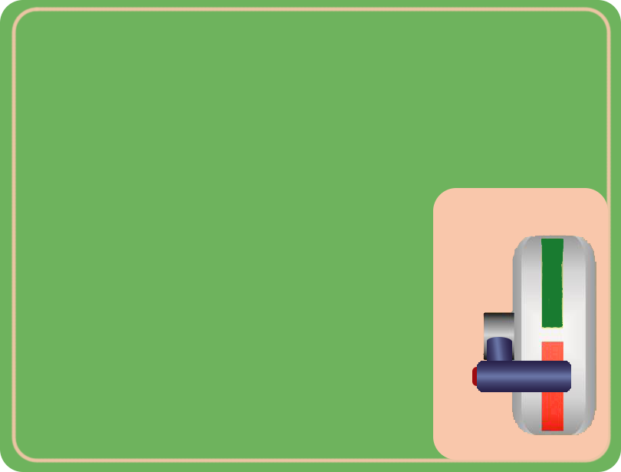
Stopping the Boat
A boat underway will drift a long way after shifting to neutral. Use reverse thrust to bring the boat to a stop.
Shift to Neutral
Straighten the wheel
Shift to reverse at idle speed
Shift to neutral when the boat reaches a complete stop
Plan ahead and be patient. Use no more than idle speed. Avoid sudden acceleration in reverse.

Slide 40

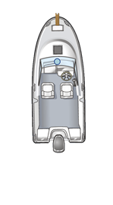
Close Quarters Maneuvers
Stay towards the center of the channel
When passing head-on, move to the right side of the channel
Make allowances for the wind
Maintain a safe distance from docks or other boats.
If you get too close to an object, STOP!
  Turning will cause your boat to pivot into the object
  Back away and turn slowly so the bow clears the object

Slide 41
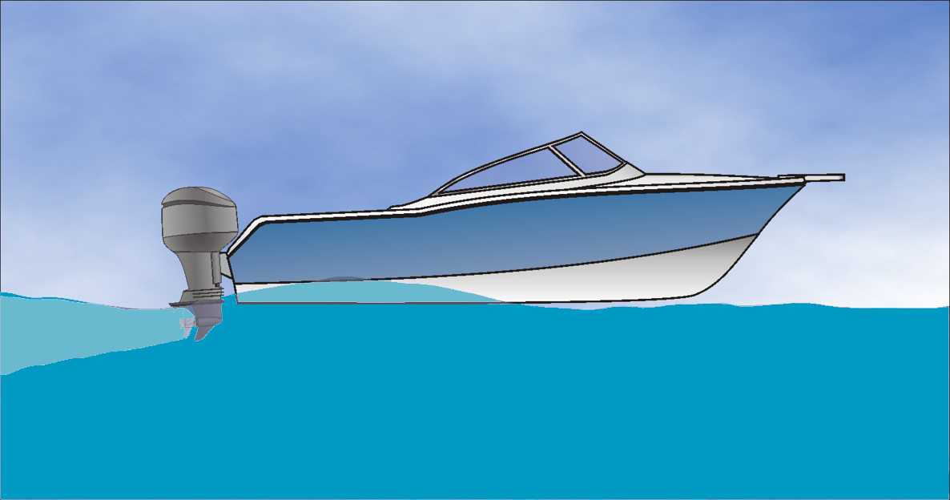
Operating On Plane
Most powerboats are designed to plane
Ride on the water vs. in the water
Speed is not constrained by the water
It takes significant power to get on plane
The boat must climb over it’s own bow wave
It takes moderate power to stay on plane

Slide 42
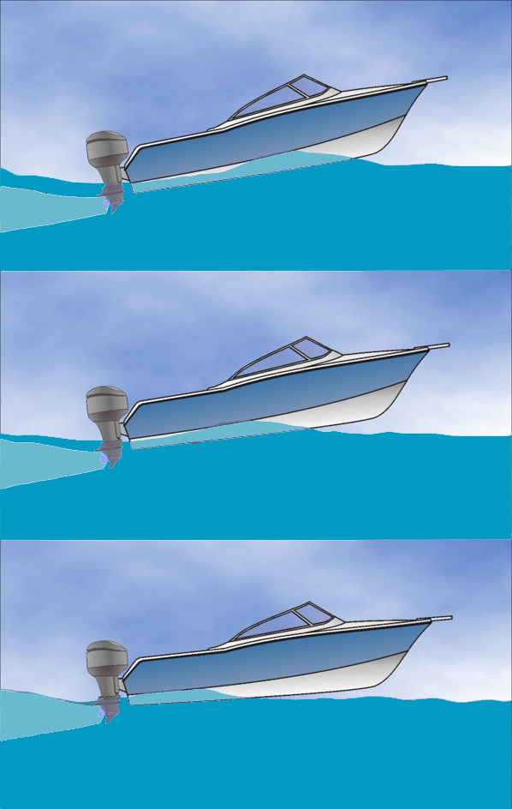
Getting On Plane
Adjust the trim of the engine in or adjust trim tabs down
Apply strong throttle to get on plane quickly and avoid excess bow rise
After climbing over the bow wave, the bow will drop
The boat will begin to accelerate
Ease the throttle as the boat reaches the desired speed

Slide 43
Adjust Trim for Operating On Plane
Trim In or Shift Weight Forward:
Reduces bow rise
Gets on plane faster
May be harsh in rough seas
Trim out or shift weight aft
Increases bow rise
Slower to get on plane
Smoother in rough seas
Extreme trim may cause the boat to porpoise

Slide 44
Maneuvering On Plane
When on plane:
The wetted surface of the boat is smaller
The pivot point moves aft
Steering becomes tighter
The boat has more directional stability
You may need to reduce speed to maneuver safely
Things happen quickly when you are on plane, so be sure to keep a proper lookout!

Slide 45
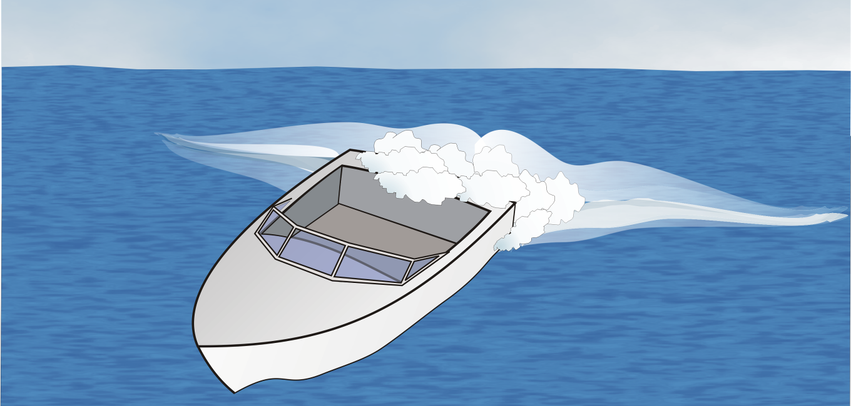
Coming Off of Plane
If you stop suddenly, your wake may overtake you
Reduce your speed speed gradually
Turn the boat to avoid taking water over the stern

Slide 46
Skill Exercises – Part I
At the Dockside / In the Fairway

Slide 47
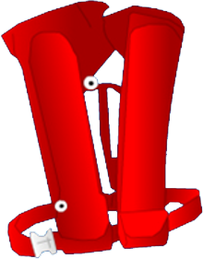
Life Jackets
Assign everyone an appropriate life jacket
Inspect each jacket to see if it is in good serviceable condition
Put the life jackets on and adjust for proper fit
Confirm all participants must be wearing their life jacket when at the dock or on the water
Notes:
ANSI On-Water Power Standard 1.1
ANSI On-Water Power Standard 1.2

Slide 48
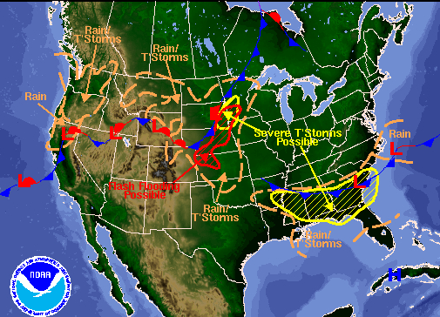
Determine Weather Conditions
Review the local forecast
Observe the current conditions
Check the weather radio
Discuss how the weather conditions, tides, and current may affect the boat
Avoid conducting exercises when:
  The wind speed is in excess of 15 MPH
  The wave height is in excess of 0.5 meters
  There is any lightning activity in the area
Notes:
ANSI On-Water Power Standard 1.1.4

Slide 49
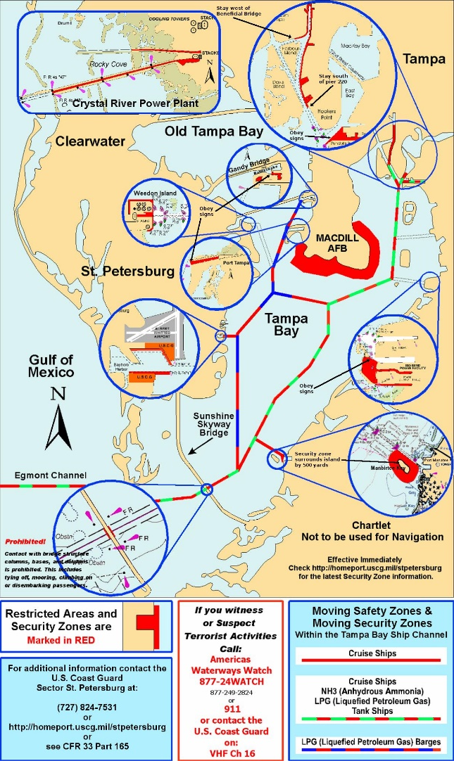

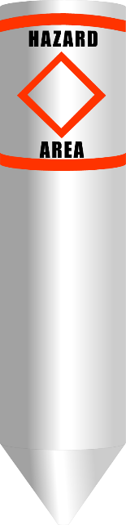
Review Local Regulations
Review the chart of the training area
Identify the navigational aids
Review any local regulations

Slide 50
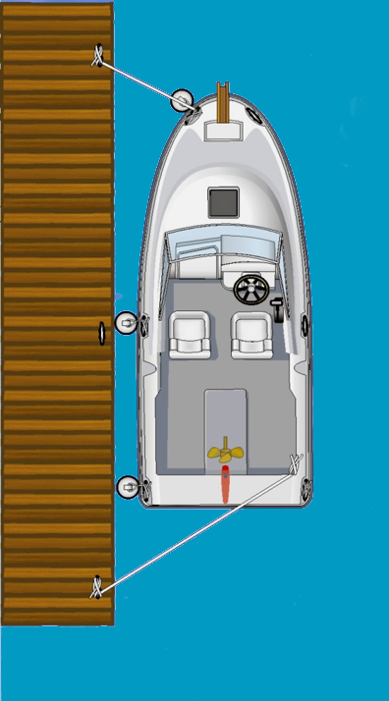
Board the Boat
Check the boat is securely tied
Use handholds and step carefully when boarding
Pass equipment aboard, don’t carry it on
Arrange passengers and gear to maintain stability
Notes:
ANSI On-Water Power Standard 1.5

Slide 51
Systems and Equipment Check
Use a checklist to inspect:
  Main boat systems
  On board equipment
  Safety gear
  Controls
  Electronics
Start the engine
  Turn on the blower
  Start the engine
  Monitor while warming
Notes:
ANSI On-Water Power Standard 1.6

Slide 52
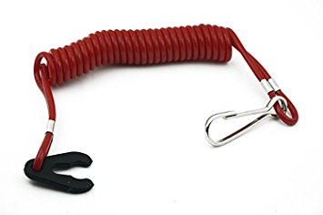
Engine Cut-off Lanyard
Always use the cutoff lanyard when underway
Secure it to the operator of the boat
  If a Velcro strap, wrap around the wrist, arm or leg
  If a clip, fasten securely to belt or life jacket

Slide 53
Steering and Throttle/Gear Shift
Make sure the boat is securely tied to the dock
Exercise the steering
  Turn the wheel completely to one side
  Turn to the opposite side, counting the turns
  Find the mid-point
Get a feel for the throttle/gear shift
  Shift to forward
  Shift back to neutral
  Shift to reverse
  Shift back to neutral
  Find the points of acceleration
  Repeat until shifting with confidence
Notes:
ANSI On-Water Power Standard 1.7

Slide 54
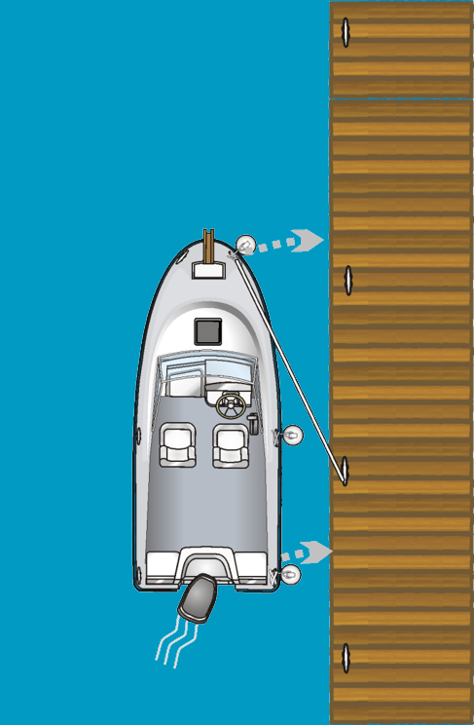
Spring Line Control
Secure the boat with an aft spring line
Turn the wheel away from the dock
Shift the boat into forward at idle speed
The boat will move gently to the dock
If you push the boat away, it will return
This position provides stability and control
Make sure the cleat is strong and your spring line secure before entering or leaving the boat.

Slide 55
Low Speed Steering
Maintain a heading at idle speed
  Steer to a specific target
  Adjust for wind and current
  Counter-steer as the boat veers off course
Left and Right Turns at idle speed
  Turn the boat crisply to the left and right as directed
  Counter-steer to halt the turn as the boat reaches the new heading
  Note the effect of wind as you turn
Notes:
ANSI On-Water Power Standard 3.3
ANSI On-Water Power Standard 3.4

Slide 56
Minimum Control Speed
Maintain a heading at minimum speed
Shift into forward briefly “1-2-3”
Shift into neutral and coast
Monitor your progress
Repeat as necessary to maintain directional control
Notes:
ANSI On-Water Power Standard 3.3

Slide 57
Stopping the Boat
Establish a heading at idle speed
Shift to Neutral
Straighten the wheel
Shift to reverse at idle speed
Shift to neutral when the boat comes to a complete stop
If you do not straighten the wheel, shifting to reverse will start to spin the boat.
Notes:
ANSI On-Water Power Standard 3.5

Slide 58
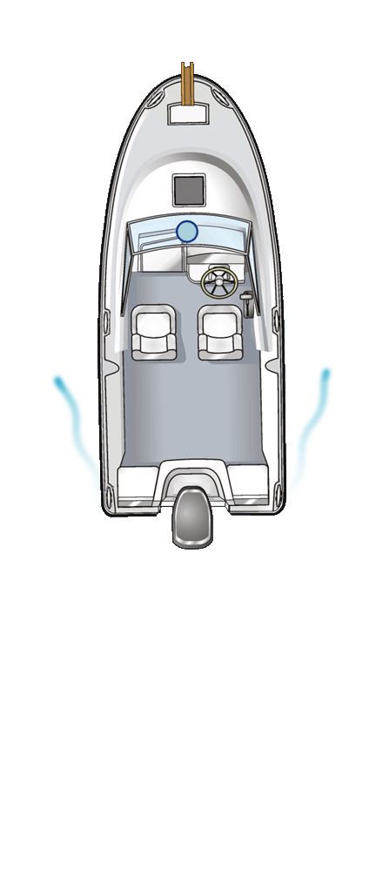
Back the Boat
Select a target astern of the boat
Shift the boat into reverse at idle speed
Keep the drive pointed at the target
Keep facing the stern while backing
Note how the boat handles in reverse
Notes:
ANSI On-Water Power Standard 3.6

Slide 59
Pivot Turn
Turn the boat within it’s own length:
Turn the wheel all the way to the right
Apply brief forward throttle
Shift to neutral as the boat makes headway
Turn the wheel quickly to the left
Apply brief reverse throttle
Shift to neutral as the boat makes sternway
Repeat the steps quickly, maintaining the rotational momentum
Monitor your position and adjust fore-and-aft as needed
To stop the turn, change the throttle without turning the wheel
A pivot turn can be made to the right or left. Use the rotational momentum of the boat to your advantage.
Notes:
ANSI On-Water Power Standard 3.1

Slide 60
Return to the Dock
Assess the wind and current
Pick your target for docking
Prepare fenders and lines
Approach the dock into the wind at a 30 degree angle
Use a steeper angle if the wind is off the dock
Use a shallower angle if the wind is on the dock
Use intermittent throttle to reduce speed
Monitor your progress and adjust for the wind and current
Notes:
ANSI On-Water Power Standard 5.1
ANSI On-Water Power Standard 5.2
ANSI On-Water Power Standard 5.3

Slide 61

Return to the Dock (cont.)
Initiate a turn as the boat nears the dock
Bring the boat along side the dock with little or no headway speed
Drop your spring line over the target cleat or piling
Secure the end of the line to your boat
Turn the wheel away from the dock and shift into forward at idle speed (the spring line control position)
If you are unsuccessful, follow your escape route and try your approach again.
Notes:
ANSI On-Water Power Standard 5.1
ANSI On-Water Power Standard 5.2
ANSI On-Water Power Standard 5.3

Slide 62
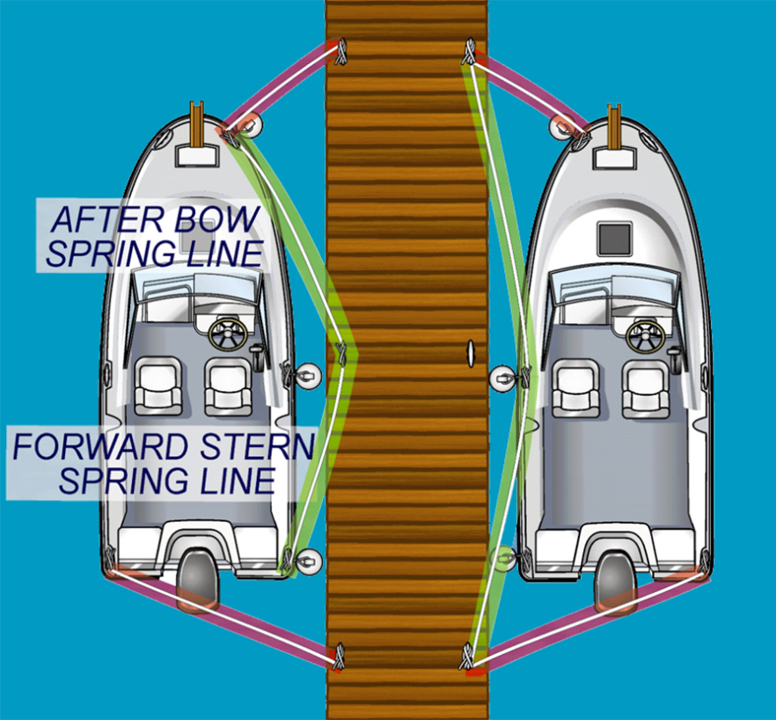
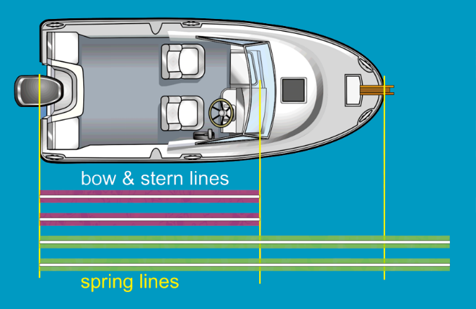
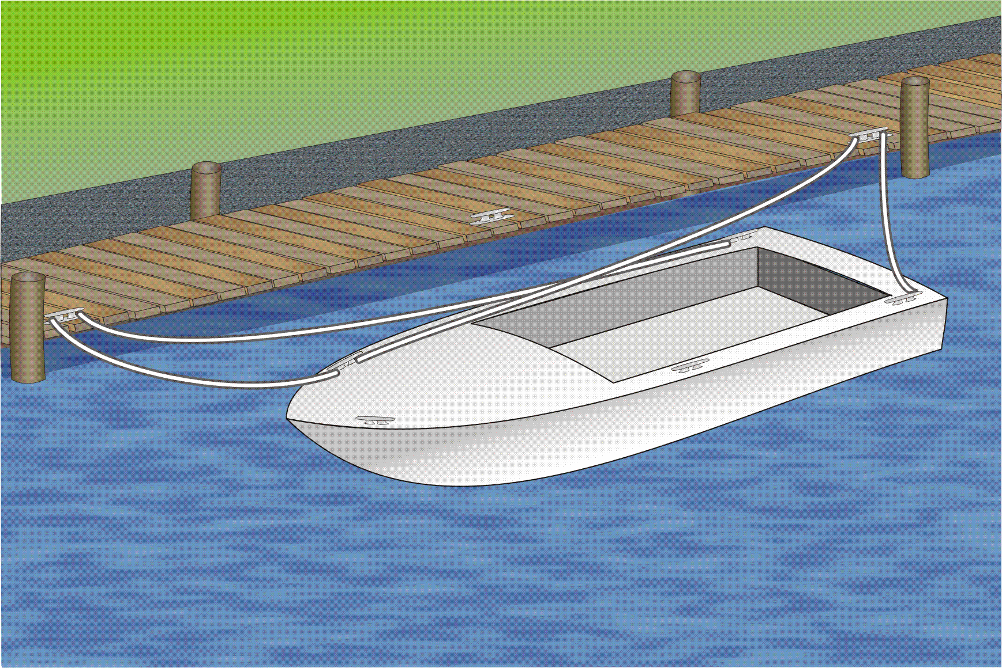

Secure the Boat
When tying to the dock:
Apply spring lines to limit fore-and-aft movement
Apply bow and stern lines to hold the boat near the dock
Use long leads if tidal conditions exist

Slide 63
Leaving the Dock
With the boat in the spring line control position:
Place a fender at near the bow
Release end of the spring line
Turn the wheel so the stern swings out
Ease the spring line to pivot on the fender
When the stern is at the desired angle, shift to neutral
Straighten the wheel
Back away from the dock
Head forward when clear of the dock
Notes:
ANSI On-Water Power Standard 2.1
ANSI On-Water Power Standard 2.2

Slide 64

Returning to Shore (Optional)
For small boats returning to shore:
Assess the conditions
Pick your landing point
Approach the shore
Use intermittent thrust to reduce speed
Watch for rocks and obstructions
Stop the engine and raise it to avoid damage
When the boat runs aground, step out carefully
Draw the boat further ashore
Secure the boat to the shore.
Notes:
ANSI On-Water Power Standard 5.4

Slide 65
Leaving from the Shore (Optional)
Assess the conditions
Release the boat from the shore
Move the boat out until it floats
Board the boat carefully
Partially lower the engine and start it
Push back from the shore
Lower the engine and use reverse when clear of obstacles
Notes:
ANSI On-Water Power Standard 2.4

Slide 66
Skill Exercises – Part II
In the Open Water

Slide 67

Use of Bearing to Avoid Collision
Maintain a constant lookout while underway
Note any vessels that are crossing your path
If the bearing to the boat remains the same, you are on a collision course, take appropriate action:
  Stand-on vessel: maintain course and speed
  Give-way vessel: make an obvious correction to avoid collision
Hint: Observe the boat against the background. If it moves forward, the boat will pass ahead. If it moves back, it will pass behind. If it remains fixed against the background , you are on a collision course.
Notes:
ANSI On-Water Power Standard 4.8
ANSI On-Water Power Standard 4.9

Slide 68

Crossing a Wake
When encountering a wake or large wave:
Crossing head-on to the wave will pitch the boat
Crossing parallel to the wave will roll the boat excessively
Cross at an angle to stretch out the wave and make it seem more gradual
Notes:
ANSI On-Water Power Standard 4.7

Slide 69
Going On Plane
Make sure your path is clear
Adjust the trim of the engine all the way in
Apply strong throttle to get on plane quickly and avoid excess bow rise
After climbing over the bow wave, the bow will drop
The boat will begin to accelerate
Ease the throttle as the boat reaches the desired speed
Notes:
ANSI On-Water Power Standard 4.1
ANSI On-Water Power Standard 4.4

Slide 70

Steering On Plane
Maintain sufficient speed to stay on plain, but not too fast to maneuver safely
Turn the boat smoothly to the left or right to new headings as directed
Note the pivot point has now moved aft
The bow of the boat tends to swing
Sharp turns will slow the boat and bring it off plane
Notes:
ANSI On-Water Power Standard 4.3

Slide 71
Coming Off Plane
Reduce the throttle gradually
The boat will begin to drop off plane
Turn the boat to avoid taking water over the stern
Notes:
ANSI On-Water Power Standard 4.4

Slide 72
Controlled Stop from Plane
Technique
  Gradually reduce throttle — avoid abrupt deceleration
  Trim the bow down slightly as speed decreases
  Remain in gear through the deceleration — do not shift to neutral
  Monitor wake — ensure it does not overtake the stern
  Warn passengers before beginning deceleration
Target
  Come to a complete stop within five boat lengths from planing speed
  Maintain control and passenger comfort throughout
Key Factors
  Sea state and wind affect stopping distance — plan ahead
  Heavier loads require more distance — adjust early
  Keep hands on wheel and eyes forward throughout
Notes:
ANSI On-Water Power Standard 4.4

Slide 73
Slalom Replacement Strategy
Key Skills Covered Under This Standard
Safe speed and throttle control
Turning techniques and the impact of speed and environmental conditions
Understanding the boat's handling characteristics
Emergency procedures
Considerations for 45-Degree Turns in Small Powerboats
Speed-to-Turn Ratio: Maintaining a safe speed to avoid excessive G-forces and potential loss of control
Hull Design: The boat's hull shape affects stability during sharp turns
Weight Distribution: Proper loading and balancing to ensure control and stability
Steering System Compliance: Ensuring hydraulic or mechanical steering systems meet ABYC or ISO requirements
Operator Training: Following best practices for safe maneuvering
Notes:
ANSI On-Water Power Standard 4.4

Slide 74
Arrive and Depart From a Mooring
Arrive at the mooring:
Approach the mooring from downwind
Use intermittent throttle to reduce speed
Bring the boat to a stop just as the mooring is reached
Use the boat hook to reach the buoy
Depart the mooring:
Release from the mooring
Back away slowly, or let the wind swing the bow downwind and depart
Hint: If the wind is strong, approach the buoy at a slight angle to the wind on the upwind side. As the boat comes to a stop, the bow will swing to the buoy.
Notes:
ANSI On-Water Power Standard 5.3
ANSI On-Water Power Standard 2.3

Slide 75

Holding Position
Use a buoy or other fixed item as a point of reference
Identify the point on the horizon the wind is coming from
Use the momentary throttle and steering to maintain position
Bow into the wind - swing the stern side to side to maintain the heading
Stern into the wind – point the drive directly at the wind and use momentary reverse
It is usually much easier to hold position stern into the wind, unless the waves are lapping over the stern.
Notes:
ANSI On-Water Power Standard 3.2

Slide 76

Steering a Range
Use two buoys or fixed objects as a visual range
Accelerate to above idle speed, but not on plane
Follow the range in
  Steer towards the nearest marker to bring the boat onto the range line
Follow the range out
  Look back at the range to observe the line, then pick a forward target for a heading
  Look back frequently, and adjust your heading as necessary
Notes:
Supplemental to ANSI Standards

Slide 77

Man Overboard
Use a fender or buoy to simulate the man overboard
Shout “MAN OVERBOARD!”
The helmsman must maintain safe operation and keep a forward lookout
Reduce speed, dropping off plane
Ask for a spotter
The spotter will point to the MOB and move forward into the sight of the helm
Initiate a controlled turn in the direction of the MOB
Plan the final approach to bring the boat to a stop on the upwind side of the MOB
Notes:
ANSI On-Water Power Standard 7.1
ANSI On-Water Power Standard 7.2

Slide 78
Man Overboard (cont.)
Have the crew ready the boat hook and the throwable device
Hold on to the throwable unless it can be delivered effectively to the MOB
Approach the MOB slowly using intermittent throttle
Bring the boat to a stop along side and upwind of the MOB
Retrieve the MOB with the boat hook
Once the MOB is secured, turn off the ignition and place the engine in gear
Help the MOB aboard the boat if it can be done safely
Otherwise secure the MOB to the side of the boat and call for help.
Notes:
ANSI On-Water Power Standard 7.1
ANSI On-Water Power Standard 7.2

Slide 79




Cleat Hitch

Slide 80


Line Handling
Heaving
Coiling

Slide 81





Additional Knots
Bowline
Sheet Bend
Round Turn and Two Half Hitches

Slide 82
Almost Time to Go!
A few very important points before we hit the water…

Slide 83
Safety
Safety is everyone’s responsibility.
Wear your life jacket at all times while at the dock or on the boat.
Check out the boat – know where safety equipment is.
Protect yourself at all times. Keep one hand for yourself, one for the boat
Keep seated at all-times unless you are at the helm or involved in a maneuver that requires otherwise.
Warn others before each maneuver.
Keep a lookout at all times. Beware of other boats in the area.
If you are not sure about something, ask!

Slide 84
Responsibility On the Water
The instructor is ultimately responsible for the passengers and the boat. The instructor carries the USPS insurance.
The current helmsman is in charge of the boat operations, and is legally responsible for what the boat does.
The rest of the passengers will act as the crew.
Be prepared to provide assistance, and follow the instructions of the helmsman. They in turn will assist you when you have the helm.

Slide 85
Follow the Instructors Lead
Follow the lead of the instructor on the water.
Feel free to ask questions, but be respectful of the time for others.
You may question some of the routines we teach. You may also know different techniques. We ask that you please perform the maneuvers as the instructor directs. Considerable input and testing went into the development of this course, and this is what our instructors are trained for.
There will be plenty of time for additional discussion after we complete the exercises.

Slide 86

And Now to the Water
Take water and refreshments
Don’t forget sunscreen
We will recap our actions on the water
The instructors will sign off on your skills
We’ll finish with a course evaluation

